Slide 1
MetLife, your Trusted Partner

Slide 2

The information contained in this presentation supports the promotion and marketing of insurance products. MetLife, its agents and representatives may not give legal or tax advice. Any discussion of taxes herein or related to this presentation is for general information purposes only and does not purport to be complete or cover every situation. Tax law is subject to interpretation, jurisdiction and legislative change. Tax results and the appropriateness of any product for any specific taxpayer may vary depending on the facts and circumstances. You should consult with and rely on your own independent legal and tax advisors regarding your particular set of facts and circumstances.
This information was compiled from outside sources and not independently verified by MetLife. This information is believed accurate and current as of October 2012. This information cannot be guaranteed and is subject to change. In the event the information presented herein differs from that of your plan document, the plan document will govern.
The performance data featured represents past performance, which is not indicative of future results. Investment return and principal value will fluctuate with changes in market conditions such that the investment may lose value.

Slide 3
Importance of a Critical Illness Cover

Slide 4



Addressing Key Customer Concerns
Concerns due to a Critical Illness
How can a Critical Illness cover address concerns
Children’s future, family protection and well-being
Focus on family – Critical Illness benefit will ensure their family’s financial security and peace of mind
Job loss and covering day to day expenses for the family
Focus on job loss – Critical Illness will result in at least a temporary loss of job and income. Critical Illness benefit will help cover day to day expenses while you focus on recovery
Is my medical insurance enough to cover critical illness expenses
Focus on gaps in medical insurance- Highlight the limitation and caps of most medical insurance plans. CI benefit can be used to seek alternative treatment or see a specialist abroad.

Slide 5

How would you manage Critical Illness Expenses?
Medical Insurance
Savings
Do you have enough savings?
Liquidate Assets
Are you willing to take a loss on the sale of your assets if market conditions are bad?
Charity
Is there a family member you can ask for help?
Critical Illness Insurance
Would you plan for the future today so that you do not have to think of any of the above?
What if you want to see a specialist abroad?
What if the treatment you want is not covered by your insurance?
If your savings are used up, how would you pay for children’s education or retirement?
How long does it take to liquidate an asset such as property?
Do you want to be a burden on others?

Slide 6

Are you ready for the unexpected?
Will your children be able to continue their education?
If you fall ill, how will it affect your family?
What if you are not here to provide for your loved ones?
How would it impact your family financial status?
Do you know what your medical insurance would cover?

Slide 7

How Critical Illness affects the UAE population
Average age when a heart attack occurs is 15 years earlier than western countries
Due to advancements in medical research and technology, the rate of recovery from critical illnesses is increasing rapidly. While this is good news, it does not negate the fact that there will be additional expenses to continue to care for and assist a survivor while they recover. 50% of people who were diagnosed with CI still face the financial consequences 3-5 years after recovery.
54% of deaths in the UAE are caused by cardiovascular diseases and cancer

Slide 8
CritiCare

Slide 9

CritiCare- Product Specifications
Age of eligibility | 18 to 50 years ( 10 years) 18 to 55 years ( 5 & 7 years)
Maximum Age at Maturity | 70 years
Mode of Payment | Monthly & Annually
Minimum Annual Premium | USD 1,250
Policy Term | 10, 15 or 20 Years
Grace Period | 30 Days
Waiting Period | 90 days after policy effective date
Premium Payment Term
Payment for: | Coverage for:
5 Years | 10 Years
7 Years | 15 Years
10 Years | 20 Years

Slide 10


Reduced Paid Up
√
  Policy is converted into reduced paid up
After the payment of 3rd annual premium or 25th monthly instalment the plan provides a Reduced Paid‑Up (RPU) benefit –
where the policy continues for the remaining duration of the policy with a reduced face amount
  Face amount will be proportionately reduced to the paid premium
  Maturity benefit will be 75% of the actual premiums paid to date.
The RPU is provided at the client’s request – or automatically at the end of the grace period.
This option is available after the payment of 3rd annual premium or 25th monthly instalment

Slide 11


Life Insurance Benefit
√
  Loss of Life
  due to Critical Illness
100% of the Sum insured is paid to the Beneficiary/ ies
or
√
  Loss of Life
  due to any other cause
Return of paid Premiums back to the Beneficiary/ ies

Slide 12
List of Covered Critical Illness
32 Critical Illnesses
Cancer
Brain Tumor
First Heart Attack
Stroke
Coronary Artery Bypass Surgery
Heart Valve Surgery
Primary Pulmonary Hypertension
Kidney Failure (End-Stage Renal Disease)
End-stage Lung Disease
End-stage Liver Failure
Coma
Blindness (Total Loss of Sight)
Deafness (Total Loss of Hearing)
Total Loss of Speech
Total Paralysis (Loss of use of Limbs)
Major Burns
Major Organ/Bone Marrow Transplantation
Multiple Sclerosis
Parkinson’s Disease
Alzheimer’s Disease/Severe Dementia
Encephalitis (Acute Viral Encephalitis)
Bacterial Meningitis
Head Trauma
Poliomyelitis
Motor Neuron Disease
Fulminant Hepatitis
Apallic Syndrome
Progressive Scleroderma
Systemic Lupus Erythematosus With Lupus Nephritis
Aplastic Anemia
Surgery to Aorta
Muscular Dystrophy

Slide 13
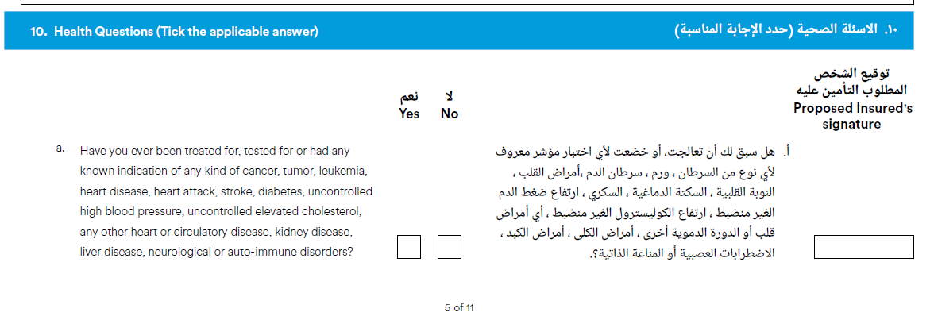
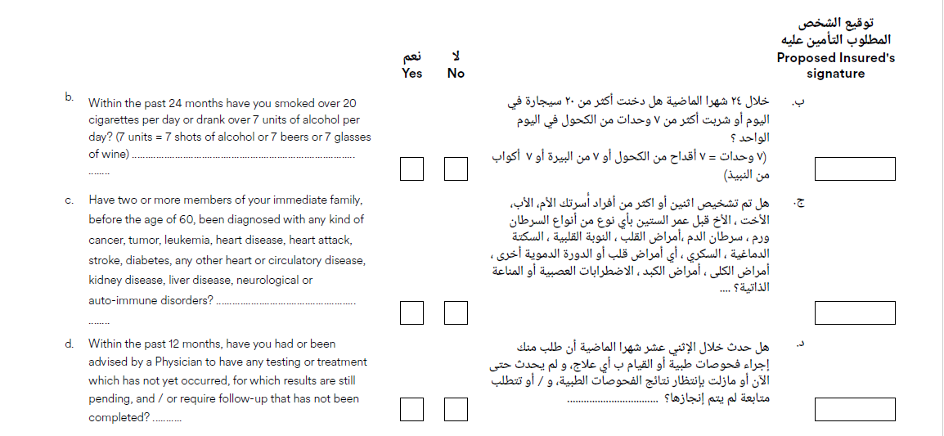
Health Questions

Slide 14
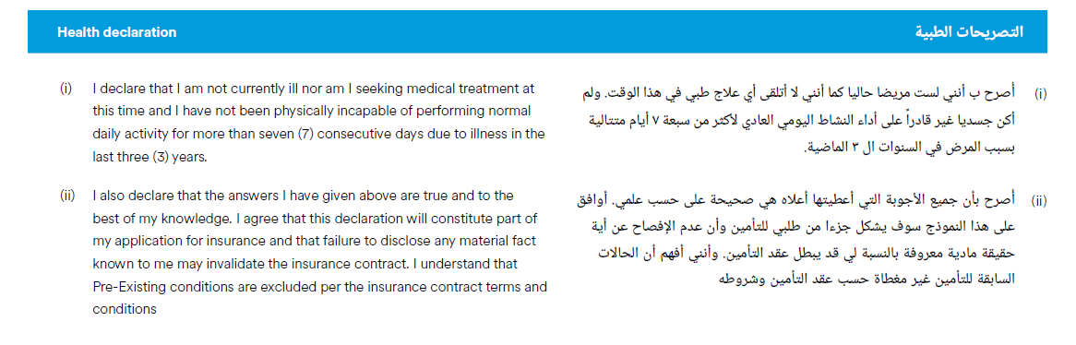
Health Declaration

Slide 15
Schedule of Benefits
Annual Premiums in USD
Premium for 10 year Term
Issue Age | Sum Assured (USD)
 | 25,000 | 50,000 | 75,000 | 100,000 | 125,000 | 150,000 | 200,000
18 to 30 | 1,250 | 2,500 | 3,750 | 5,000 | 6,250 | 7,500 | 10,000
31 to 35 | 1,625 | 3,250 | 4,875 | 6,500 | 8,125 | 9,750 | 13,000
36 to 40 | 2,000 | 4,000 | 6,000 | 8,000 | 10,000 | 12,000 | 16,000
41 to 45 | 2,500 | 5,000 | 7,500 | 10,000 | 12,500 | 15,000
46 to 50 | 3,250 | 6,500 | 9,750 | 13,000 | 16,250 | 19,500
51 to 55 | 5,000 | 10,000 | 15,000 | 20,000 | 25,000 | 30,000
Premium for 15 year Term
Issue Age | Sum Assured (USD)
 | 25,000 | 50,000 | 75,000 | 100,000 | 125,000 | 150,000 | 200,000
18 to 30 | - | 1,750 | 2,625 | 3,500 | 4,375 | 5,250 | 7,000
31 to 35 | - | 2,250 | 3,375 | 4,500 | 5,625 | 6,750 | 9,000
36 to 40 | 1,500 | 3,000 | 4,500 | 6,000 | 7,500 | 9,000 | 12,000
41 to 45 | 2,000 | 4,000 | 6,000 | 8,000 | 10,000 | 12,000
46 to 50 | 3,000 | 6,000 | 9,000 | 12,000 | 15,000 | 18,000
51 to 55 | 3,500 | 7,000 | 10,500 | 14,000 | 17,500 | 21,000
Premium for 20 year Term
Issue Age | Sum Assured (USD)
 | 25,000 | 50,000 | 75,000 | 100,000 | 125,000 | 150,000 | 200,000
18 to 30 | - | 1,250 | 1,875 | 2,500 | 3,125 | 3,750 | 5,000
31 to 35 | - | 2,000 | 3,000 | 4,000 | 5,000 | 6,000 | 8,000
36 to 40 | 1,375 | 2,750 | 4,125 | 5,500 | 6,875 | 8,250 | 11,000
41 to 45 | 1,750 | 3,500 | 5,250 | 7,000 | 8,750 | 10,500
46 to 50 | 2,250 | 4,500 | 6,750 | 9,000 | 11,250 | 13,500

Slide 16
CritiCare
Positioning

Slide 17



Journey of a Critical Illness Survivor
Ahmad, 38, moves to Dubai with his wife and 5 year old son
Ahmad opens a bank account and builds a relationship with his RM
Ahmad’s RM asks about any safeguards for his family in case something unexpected happens to him and he is unable to provide for his family
After reviewing his options, Ahmad buys CritiCare which pays out a lump sum in case he is diagnosed with a critical illness
Ahmad gets a promotion and purchases a house on mortgage. He also takes out a loan to start a new business on the side
Ahmad recovers from the cancer but is now temporarily disabled. He uses some of the lump sum payout to outfit his home to meet his needs. He also goes on a well-deserved vacation with his family.
Ahmad flies to the US with his wife to try an experimental treatment. While this is not covered by his existing medical plan, he uses some of the lump sum cash to cover the treatment and travel expenses.
Ahmad makes a claim and receives a US$200,000 lump sum payout. While he and his family focus on getting better, the additional cash was used to pay for his son’s education, the mortgage and loan obligations and other day to day expenses
During his annual check-up, Ahmad is diagnosed with a rare cancer. The treatment schedule forces Ahmad to stop working. His doctor also recommends seeing a specialist in the US.
Ahmad enrolls his son in an international school which costs AED 60k/year (excluding other fees and activities)

Slide 18

Why you would need and use a Critical Illness payout
Need home renovations to make the home more comfortable during and after recovery
Due to numerous hospital appointments and stays you can only work part -time
Due to critical illness you lose your job
You want an experimental or innovative treatment which is not covered under your medical insurance
Whilst recovering, you may wish to give up work
You want to take the treatment in a different hospital or country to where you have insurance
Your insurance does not cover your condition – e.g. you have breached your max yearly limit, or you have a high co - pay
After recovery from a CI, you may want to travel – carry out your bucket list
18

