Slide 1
Forever

Slide 2
Forever
Income for life
Monthly income in case of PPD or PTD due to accident or sickness, for minimum 20 years
Annual plan - Age 18-59 years
Annual, 3 & 5 year
single premium modes
Age is 18-57 for 3 year single premium
Age is 18-55 for 5 year single premium

Slide 3
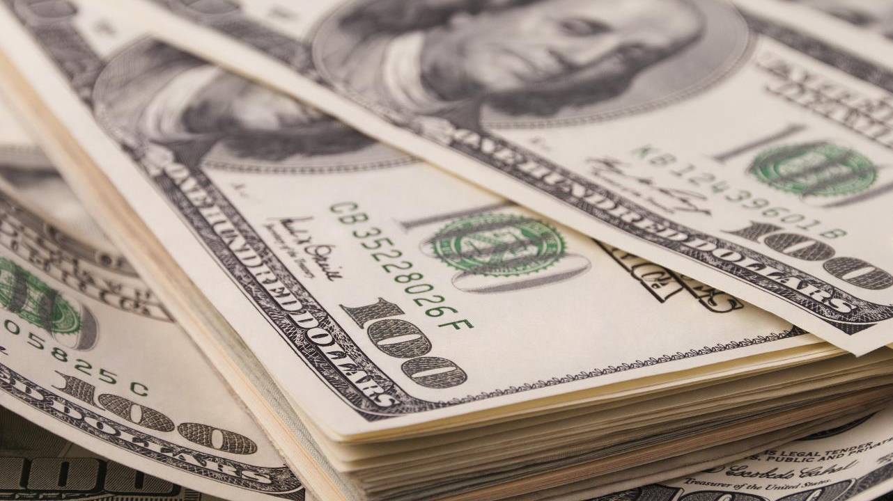
Conditions
Limits USD $
Minimum limit | $ 250
Maximum limit | $ 3000
Class A Class B | Minimum limit $ 750 (Annual)/$500(Single) $500
Class C | Maximum limit $ 500
Class D | Maximum limit $ 250

Slide 4
Mode of Payment
Available in Annual, Semi Annual
and Single Premium
Minimum Annual Premium - $ 200
Minimum Single Premium - $ 400
Policy specimen and conditions attached

