Slide 1
Investor Advantage:
An investment solution

Slide 2
With Investor Advantage you get an investment opportunity that will help you maximize on your today’s ability to save for the future you are dreaming of.

Slide 3
How The Plan Works
Envision the Financial Dream you would like to achieve
Customize your Investor Advantage Plan to suit your financial aspirations by selecting the:
At Maturity, access your accumulated funds and make your dreams a reality!
Feature | Details
Contribution Period | 12,24,36 or 48 months
Payment Mode | Monthly or Annual
Currency | USA, GBP or Euro
Investment Strategy | Conservative, Balanced or Aggressive

Slide 4
Plan at a glance
Variable Universal Life product written to mature at age 95
Can be sold to Both Resident and Non-Residents
Premiums are payable for a fixed term (1 year, 2 years, 3 years and 4 years)
Plan with a strong investment focus where the death benefit is 101% of the Account Value
Free partial withdrawals allowed (subject to limitations)
Lump sum benefits payable on maturity, loss of life, or surrender (based on the Account Value of the policy)
Annualized First year commission (function of the premium paying term)

Slide 5
Choice between 3 fundamental investment strategies: Conservative, Balanced and Aggressive Up to 180+ direct funds to select from Free Premium Redirection Free Un-Limited Switches
Investment Choices

Slide 6
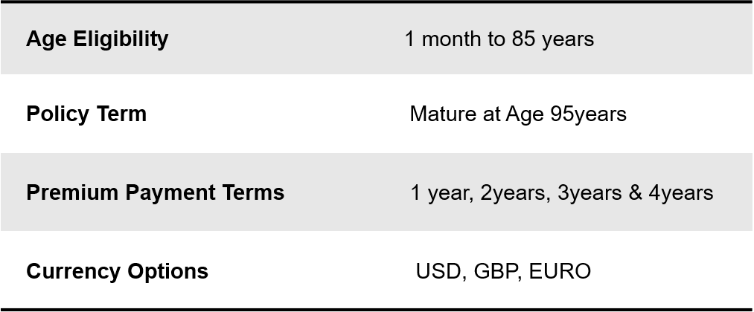
Plan Benefits

Slide 7
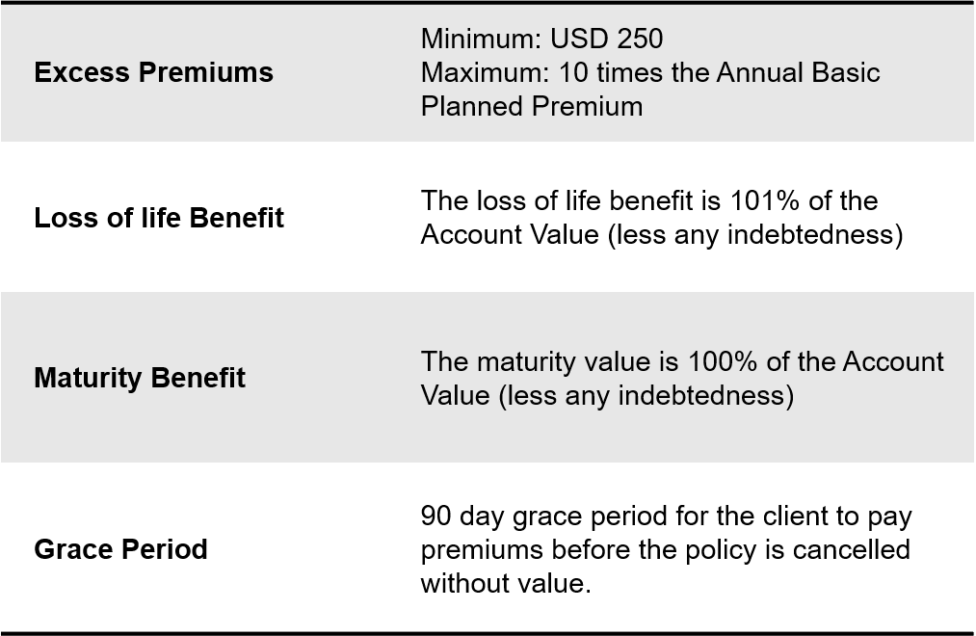
Plan benefits- continued

Slide 8
Plan charges
Premium
Charge
M & E
Charge
Premium Load (Excess Premium)
Based on the premium payment term & policy year & is applied on Basic Planned Premium.
It’s a monthly charge taken from account value. (annual charge divided by 12 )
.
M&E Charge is a percentage of the Account Value, where the %
depends on the policy year and account value
Deducted from the Account Value at the start of each policy month (annual charge divided by 12 )
The premium load on the Excess Premiums is 3%, applied to each Excess Premium
received during the first 10 policy years only.
There is no Premium Load for Basic Planned Premium
No Policy Fee
No Bid/Offer Spread
No Premium Modal Load

Slide 9
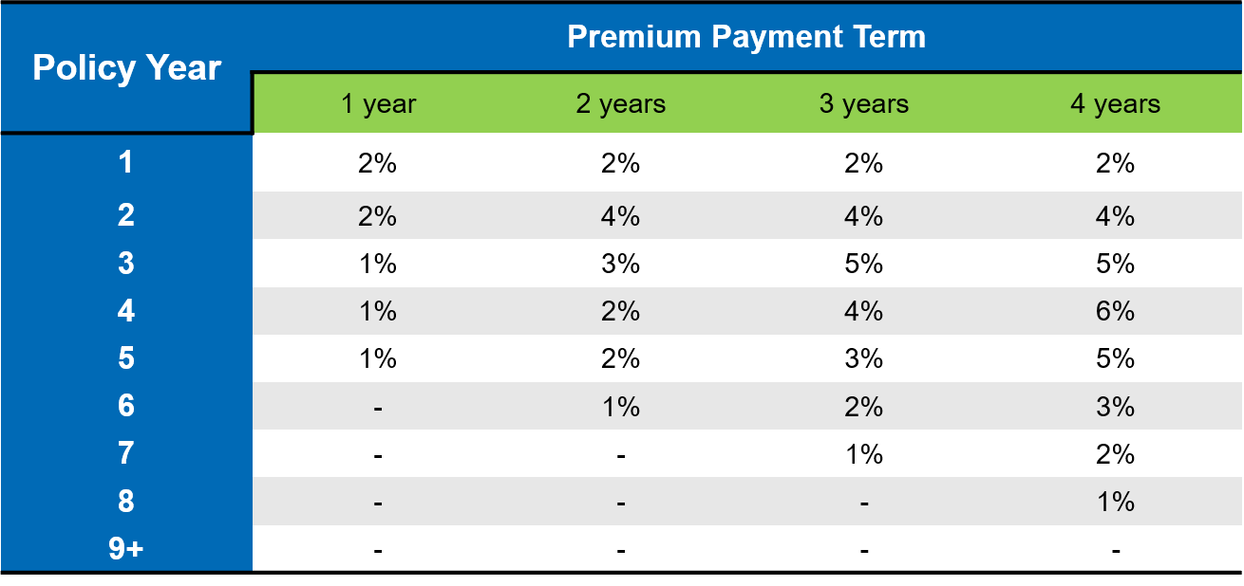
Premium Charge
Annual Premium Charge (% Basic Planned Premium)

Slide 10
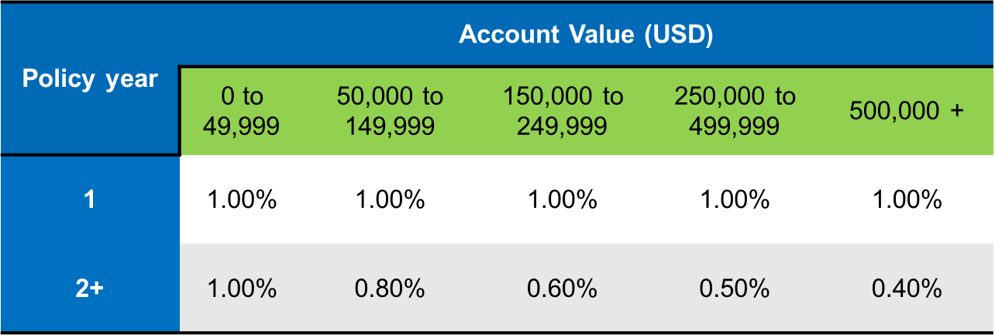
M&E Charge

Slide 11
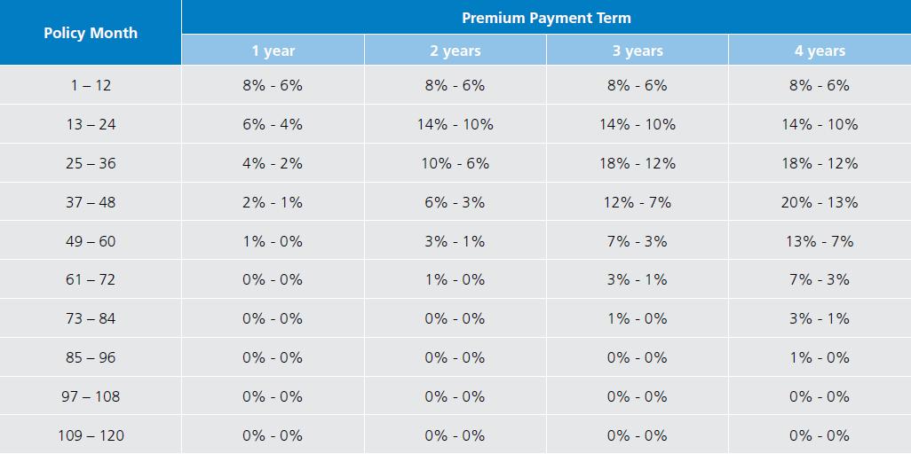
Liquidity Options
Full Surrender | Free Partial Surrender | Charged Partial Surrender
Surrender Charges
Are a factor of Basic Planned Premium
Are not linked to the Account Value
Depend on the premium payment term and the policy month of surrender
Client not penalized for the growth of the Account Value

Slide 12
Full Surrender
At time of Full Surrender Client Gets : Net Cash Surrender Value
What is:
Net Cash Surrender Value: Cash Surrender Value less any indebtedness
Cash Surrender Value: Account Value less applicable Surrender Fee and expense recoupment charge
Surrender Fee:
a percentage of the Basic Planned Premium
depends on the premium payment term and the policy month of surrender.
Account
Value
-
Applicable Surrender Charge
-
Indebtedness
if any

Slide 13
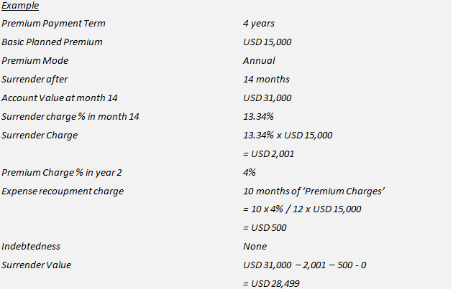
Example of full surrender

Slide 14
Free partial surrender
A maximum of four free partial withdrawal is allowed in each policy year.
The maximum amount of a free partial withdrawal depends on the premium payment term of the policy and whether the withdrawal is taken before or after the premium payment term.
Before the end of premium payment term
The remaining Account Value after the withdrawal should be at least equal to the total premiums paid till the point of withdrawal
After the end of premium payment term
*SC is the Surrender Charge applicable at the point of withdrawal

Slide 15
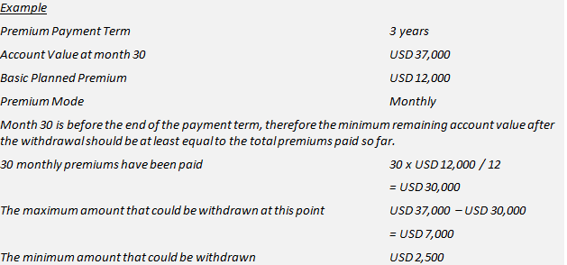
Example of free partial surrender

Slide 16
Partial Surrender
Partial Surrender amount
Partial
Surrender
X
Full Surrender Charge
=
Full Surrender Value
Notes:
The client may specify how much of the surrendered amount is to come from the various investment sub‑accounts.
If no specific request is made, the partial surrender will be deducted pro‑rata from each of the sub‑accounts.

Slide 18
Thank You

