Slide 1

Virtual Sales Process

Slide 2
Step 1 - Pre-Sales/Prospecting

Slide 3
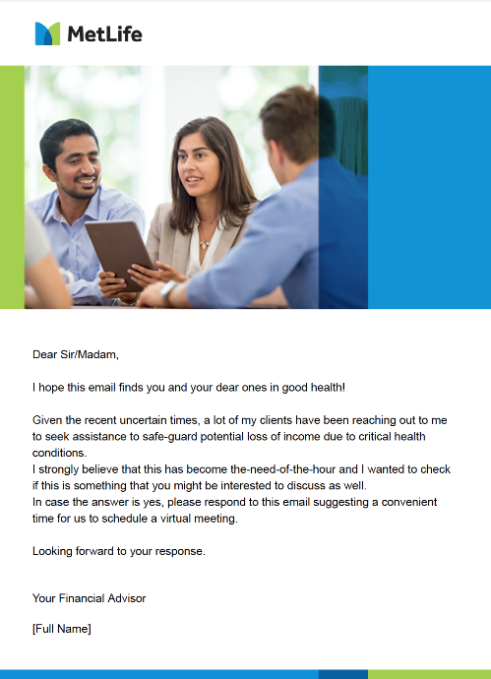
Email/WhatsApp
Dear Sir/Madam,
I hope this email finds you and your dear ones in good health!
Given the recent uncertain times, a lot of my clients have been reaching out to me to seek assistance to safe-guard potential loss of income due to critical health conditions or accident or disability.
I strongly believe that this has become the-need-of-the-hour and I wanted to check if this is something that you might be interested to discuss as well.
In case the answer is yes, please respond to this email suggesting a convenient time for us to schedule a virtual meeting.
Looking forward to your response.
Your Financial Advisor
[Full Name]

Slide 4
Step 2 - Tele-Sales

Slide 5

Introduction
Good morning/afternoon/evening, Am I speaking to ABC!
My name is XXX and I’m calling you in response to your email wherein you have expressed your interest to understand possible solutions that can help safeguard against potential loss of income due to critical health conditions or accident or disability.

Slide 6

Unavailability / Call Back
Not a good time to call: I apologize for the inconvenience. When would be the best time to call you/him/ her?
Thank you, I will call back then. Have a great day! Note: Make sure you call the customer the time that he has specified as it makes him feel important.
Not the client/No: Is there another contact number where I can call Mr. /Ms. First & Last Name?
If out of town/on vacation: We would like to get in touch with Mr. /Ms. First & Last Name. May I ask when he/she is coming back so I can get in touch with him/her then?
Thank you very much, have a nice day!

Slide 7

Availability
If “Yes” or “OK”:
Do you have a minute for me to discuss this further?
If “not interested”:
Deliver appropriate rebuttal

Slide 8
Gathering Information
As per our system your age is XX, can you confirm your complete DOB with the month and the date Mr. /Ms. …………….?
(Calculate his / her age and based on prospect’s need and objective offer the appropriate product by referring to the product USP’s and KFD for Coverage / Benefit Grid )
E.g. Age 35 for just USD XXX monthly, that is for just over XXX USD a day, you are covered for USD XXX / benefits .
No medical tests required, no need to fill out lengthy documents, and even physical meeting is not required.

Slide 9
Guaranteed Income Plan ( GIP)
Eligibility | Benefits | USP’s
Entry age: 18 -66 years for annual & 3-year single premium 18-65 years for 5-year single premium 18-63 years for 7-year single premium 18-60 years for 10-year single premium Minimum coverage: $ 500 Maximum coverage: $ 15,000 Minimum premium -$ 200 (annual), Single Premium - $ 400 | Monthly Annuity payable for 10, 15 or 20 years in the event of: • Loss of Life due to Accident • Dismemberment, Loss of Sight, Hearing or Speech due to Accident • Permanent Total Disability due to Accident The Monthly Annuity is guaranteed to be paid for the specific duration selected (i.e. 10, 15 or 20 years maximum) Grace Period -60 days (for annual mode) & 30 days (for semi-annual / quarterly mode) Reinstatement- Within 6 months from date of lapsation | Income replacement due to Accidental Death, PPD & PTD Guaranteed monthly payout over a 10 year, 15 year or 20 year period. Pre-Underwritten i.e. No Medical No Illustration required Annual premium mode coverage expires at age 75. Single premium expires at age 70 Single Premium has discounts 3 Years – 5% 5 Years – 10% 7 Years – 15% 10 Year – 20%
Eg : For monthly income of $ 15,000 pay only USD 4,778 PA/USD 398 PM for a Guaranteed Benefit of $ 3.6m over 20 years

Slide 10
Forever Plan
Eligibility | Benefits | USP’s
Entry age: 18 -59 years for annual 18-57 years for 3-year single premium 18-55 years for 5-year single premium Minimum coverage: $ 250 Maximum coverage: $ 3,000 Minimum premium -$ 200 (annual), Single Premium - $ 400 | Permanent Partial Disability and Permanent Total Disability due to Accident or Sickness Monthly benefit payable for the lifetime of the insured with a minimum guaranteed benefit period of 240 months Worldwide coverage Grace Period -60 days (for annual mode) & 30 days (for semi-annual / quarterly mode) Reinstatement- Within 6 months from date of lapsation | An insurance plan that provides a lifetime promise of financial security Stand-alone and also as rider with life Annual mode’s coverage expires at age 65. Single premium expires at age 60. Single Premium has discounts 3 years – 5% 5 years – 10%

Slide 11
Olympic Plan
Eligibility | Benefits | USP’s
Entry age: 18 -66 years for annual & 3-year single premium 18-65 years for 5-year single premium 18-63 years for 7-year single premium 18-60 years for 10-year single premium Minimum coverage: 1 unit Maximum coverage: 6 units Minimum premium – premium for 1 unit | Accidental Death /Permanent Partial/Permanent Total Disability AMR Accident In-Hospital income White collar (Class A & B) Blue Collar (Class C & D) | Individual package & Family package Family package covers insured, spouse & 2 children (free) Grace Period (60 days) for annual mode Reinstatement – within 6 months from due date Single Premium has discounts 3 years – 5% 5 years – 10% 7 years – 15% 10 years – 20% Annual mode’s coverage expires at age 75. Single premium expires at age 70.

Slide 12
Worldwide Coverage
This plan is fully portable and offers worldwide coverage
(except for sanctioned countries.)
Mr. /Ms. First & Last Name, please note that MetLife will NOT provide COVERAGE AND/OR PAYMENT under the Policy and/or any Supplementary Contract if the policyholder, insured, or person entitled to receive such payment is residing in any sanctioned country or claiming the payment for any services received in any sanctioned country.
Would you like to know what are the current sanctioned countries?
If YES, read out the sanctioned countries and then proceed to the next statement.
If NO, you may proceed to the next statement.
Please also note that MetLife will NOT provide COVERAGE AND/OR PAYMENT under the Policy and/or any Supplementary Contract if the policyholder, insured, or person entitled to receive such payment is listed on the Office of Foreign Asset Control (OFAC) Specially Designated Nationals (SDN) list or any other International or local sanction list.

Slide 13
Step 3 – Enrollment Process (1-2)

Slide 14

Enrollment Process
This plan will provide you with the necessary peace of mind and income protection in the event you suffer from a critical health condition ,accident or disability for as low as XX USD a day- which is only XX USD a month/annually! This policy is brought to you by MetLife.
If yes – Open the Application form and Continue to Health Declaration
Note: customer must answer with a clear ‘yes’ before continuing.
Maybe – Uh Huh
I am sorry Sir / Ma’am, I need your enrolment confirmation in either a clear ‘Yes’ or ‘No’
If No - Deliver appropriate rebuttal.

Slide 15
Enrollment Process
Before we enroll you Mr./Mrs. (Customer First Name & Last Name)
(Appropriate Questions depending on the product )
Please confirm your understanding of these conditions.
(Applicant must respond with a clear Yes/No. A “No” answer would trigger a Decline.)
Great! With your permission, I would like to pre-fill your application form.

Slide 16

Documentation
Right after this call, I will be emailing you your pre-filled application form for your review and signatures (we accept digital signatures).
Kindly click on ‘next’ button after digitally signing the application form. And email the same back to me with the below documents
Passport ID with Visa
Preferred method of payment
(Credit Card or Bank Transfer)

Slide 17

Closure
Once your application is processed, you will receive a Welcome call from MetLife’s call-center to take your Credit Card details to debit the premium.
Alternatively, you can also do a bank transfer to pay the premium.
Following the premium collection, you will be receiving the policy document from MetLife via email.
Thank you, sir/madam, it’s been a pleasure to serve you.

Slide 18
Thank You

